Slide 1
WELCOME TO THE END YEAR PROJECT
This project is made by me, Shreyash with the help of parents.
BY SHREYASH GHIMIRE

Slide 2
|||
Password Protection
Password Protection
Password protection is a defense technique against unauthorized access that helps keep important data like emails, passwords and other authorization method secure from hackers or unknown users. Password protection is one of the most common data security tools but they are easily bypassed if not created.
Search Engine
Copyright Protection
Why password protection is important?
Cyber Bullying
Password protection is important because it helps to protect our important data safe from malicious software and determines how a effective a password is against an attack. It also reduces a risk of hacking our authorization data.
About Me
>

Slide 3
|||
How do passwords get hacked?
Passwords usually gets hacked when our password is weak or mostly used common passwords like 12345, 0987654321, 11111, name@123, etc. Password is mostly hacked by brute-force attack which uses a trial and error to crack passwords and other login credentials. The best way to protect password against hackers is to create a strong password.
Password Protection
Search Engine
Copyright Protection
How to create a strong password?
Cyber Bullying
Follow these guidelines to create strong passwords;
Use at least 8 to 12 characters in all accounts.
Use a combination of letters, numbers and special symbols.
Use a different passwords for each of our accounts.
Don’t use name and birth date or other common password that can be easily guessed by others.
About Me
<
>

Slide 4
|||
Search Engine
Password Protection
Search engine is a software engine that finds web pages that match a web search according to the user’s query. It searches a World Wide Web (WWW) in a systematic way for particular information specified in a textual web search query. In present, there are many search engines provided on the internet. Some of them are Google, Yahoo, Baidu (mostly used all over the china), etc.
Search Engine
Copyright Protection
Cyber Bullying
How to access a search engine?
For many users, a search engine is accessed through a browser on their computer, mobiles, tablets or any other devices. Today most new browsers use omnibox or a text box at the top of the browser. When we search in search engine then we will be redirect to results containing most of the webpages then we can navigate to our useful webpage.
About Me
<
>

Slide 5
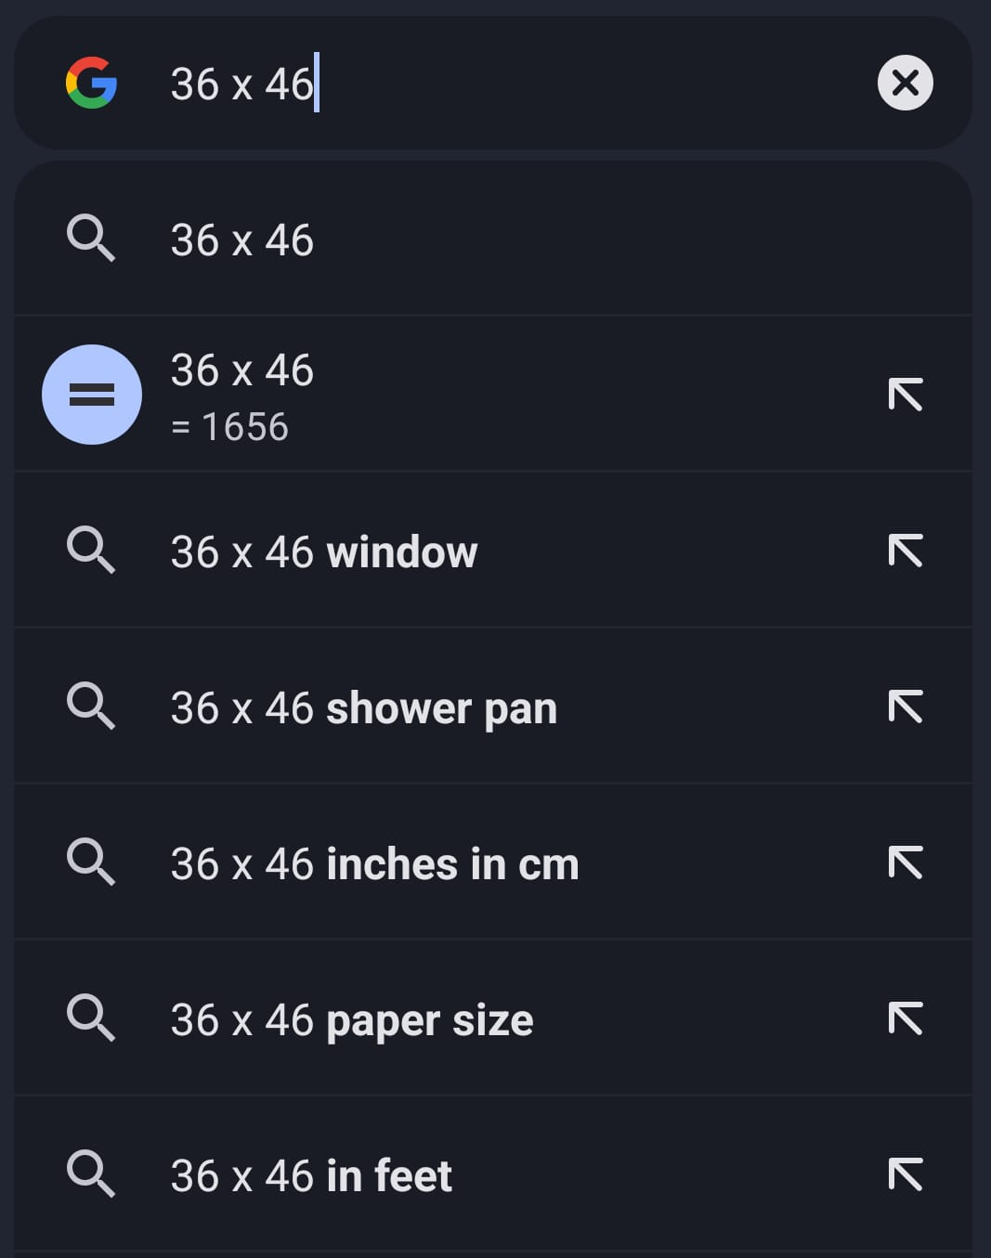
|||
What is omnibox search?
An omnibox is a traditional web browser address bar that uses some algorithms to perform operations or calculations and display that as a result and also display web links as a result at the same time which is also shown in picture which contains both calculations and also‎ ‎ web searches. This is omnibox which gives both web searches and calculations.
Password Protection
Search Engine
Copyright Protection
Cyber Bullying
About Me
<
>

Slide 6
|||
Copyright Protection
Password Protection
Copyright is a law that gives the owner and protects our creative works. It means that we have the right to decide what other people can do with our work, such as copying, sharing or changing it. We can automatically own the copyright to anything we write, draw, compose or create. Copyright helps us to create our work original and prevent others for using it.
Search Engine
Copyright Protection
Cyber Bullying
About Me
<
>

Slide 7
|||
Length of copyright protection.
Copyright laws usually protect owners of copyright beyond their lifetime, such as until 50 years after the author's death. In some countries this period has been extended to 70 years. When the period of copyright protection has ended, the written document, musical composition, book, picture, or other creative work is in the public domain. This means that no one owns the copyright and everyone is free to copy, use and change them without having to ask for permission or pay the owner. Copyright does not prohibit all copying or replications.
Password Protection
Search Engine
Copyright Protection
Cyber Bullying
About Me
<
>

Slide 8
|||
Cyber Bullying
Password Protection
Cyber bullying is a bullying that takes places over digital devices mostly occurs online, often through instant messaging, text messages, email, and social networks. Cyberbullying may be the same age as the victims, or they may be older age. Cyber bullying includes sending, posting, or sharing negative, harmful, false, or mean content about someone else. It can include sharing personal or private information about someone else causing embarrassment or humiliation. It also causes peoples to be depressed and they ultimately thinks the solution is suicide.
Search Engine
Copyright Protection
Cyber Bullying
About Me
<
>

Slide 9
|||
Cyber bullying tactics;
It is important to understand how children are cyberbullied so it can be easily recognized and action can be taken. Some of the most common cyber bullying includes;
Posting comments or rumors about someone online that are hurtful or embarrassing.
Pretending to be someone else online in order to post personal or false information about someone else.
Posting hateful names, comments or content about any race, religion ethnicity.
Nude photo sharing while dating online and blackmailing after breakups for posting and other social sharing.
Bullying economically on his clothes and sneakers, which are not the most expensive brands,
Encouraging self harm or suicide after blackmailing.
Password Protection
Search Engine
Copyright Protection
Cyber Bullying
About Me
<
>

Slide 10
|||
About Me
Password Protection
My name is Shreyash Ghimire. I am 11 years old. I like to play football. This project is done by me with the help of my parents. This projects gave me a lots of ideas, knowledge and educational information. I have such a good experience doing this project. I learn something new in the best way possible. While doing the project I searches on the web to find out the solution and ask my parent about it. Then I analyzed the concept and have written in my own words the best way possible I learnt.
Search Engine
Copyright Protection
Cyber Bullying
About Me
I greatly thank you my digi school and saurab sir for giving me a project which have helped to gained extra knowledge.
<

